Slide 1
I will explain how animals adapt to their environment by describing animal defenses and answering various questions..

Slide 2
Relevant Learning:
We have already learned about how some animals adapt to their environment and how plants do to.
We talked about the different body structures that animals have that allow them to survive in their environment.
Stop and think about a couple that we have discussed.
  Once you have a couple, put your finger on your nose.
    Now turn and share with your partner.

Slide 3
Today
Today, we are going to learn about animals defense.

Slide 4
Key Vocabulary:
Camouflage- coloring, shape, or size that helps some animals blend in with or look like their environment.
Mimic-to imitate the way an animal behaves.
Mimicry- organism looks like another organism.

Slide 5
Stop and think…
What does camouflage help an animal do?
  A. get oxygen
  B. blend in with its environment
  C. make food
Which vocabulary word best completes the sentence below?
  When a caterpillar looks like a snake, this is an example of ____.
    A. camouflage
    B. mimic
    C. mimicry

Slide 6
Review
Animals must be adapted to the places they live.
Animals have adaptations to help them meet their needs.
An adaptation is anything that helps a living organism _____ in its ______.

Slide 7
Adaptations that Help Defend…
These adaptations protect the animal from being eaten.
The way an animal look may protect an animal.
The way an animals behaves may protect the animal.

Slide 8
Stop and think…
Which statement is not true?
  A. All animals have adaptations.
  B. Webbed feet are an adaptation.
  C. Behaviors are not adaptations.

Slide 9
Let’s take a look at camouflage!
This is the coloring, shape, or size that helps an animal blend in with the place it lives.
A butterfly may look like a flower.
A fish may look like a stone.
A prairie dogs fur is the same color as the tall grasses that grow where it lives.
  It is hard to see the prairie dog when it is hiding in these grasses.

Slide 10
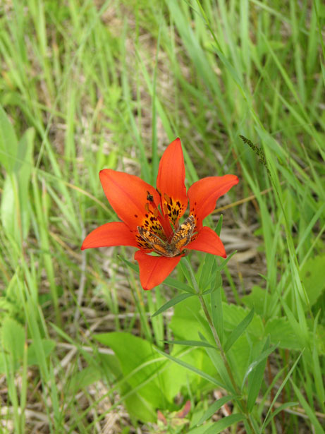
Can you see the butterfly?

Slide 11
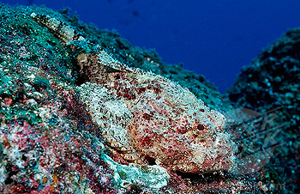
What about the fish?

Slide 12
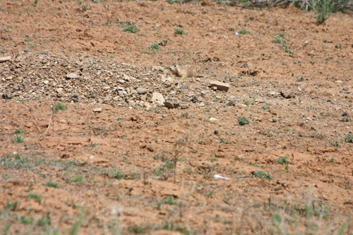
Can you see the prairie dog?

Slide 13
Continued…
The Mexican horned lizard lives in rocky desert areas.
  The color and texture of its body allow this animal to blend in with the sand and rocks of its environment.
The green anole is a lizard.
  Its color can change from green to brown, which allows the animal to blend in among green plants and brown tree branches.

Slide 14
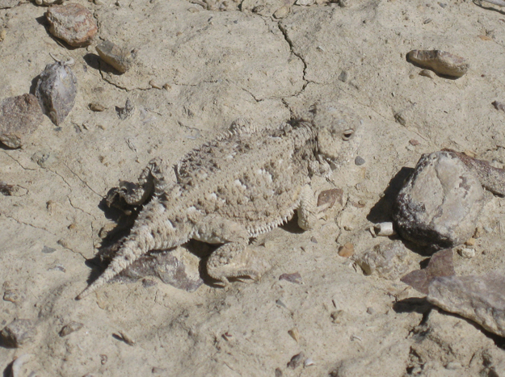
Can you see me? I am the Mexican horned lizard.

Slide 15
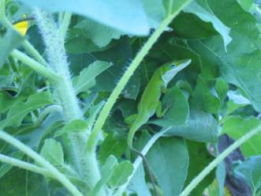
What about the green anole lizard?

Slide 16
Camouflage continued…
A zebra stripes help it blend in with the rest of the herd.
  This makes it harder for a lion to single out one zebra to attack.
The insect known as the walking stick is very hard to see.
  Its shape and color make it look like a twig.
  When it is in danger, it folds its legs against its body and does not move.
  It looks just like a stick.

Slide 17
Continued…
The chameleon is a lizard and it can change color to match the color of its surroundings.

Slide 18
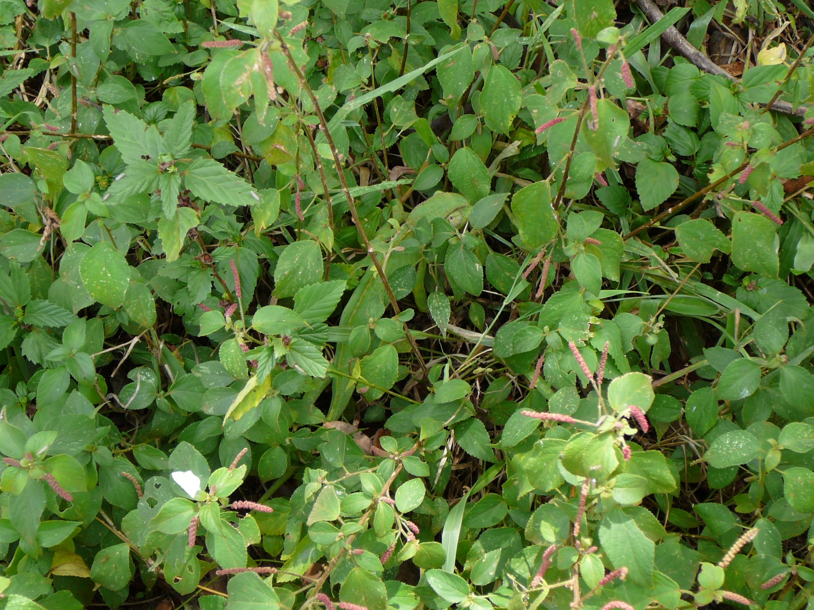
Let’s look at each of these.
Chameleon.

Slide 19
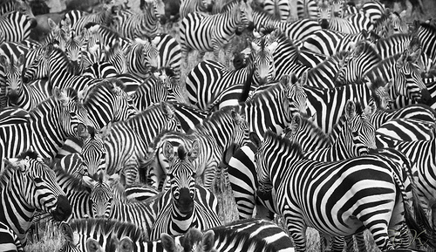
Zebra

Slide 20
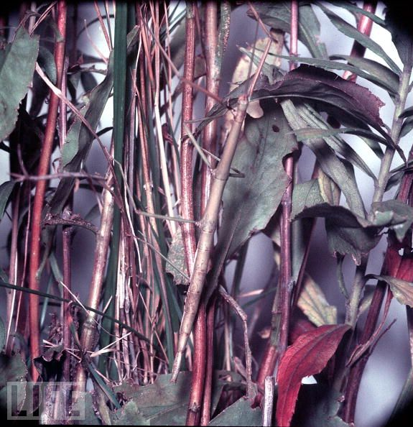
Walking stick

Slide 21
Stop and think…
Camouflage helps an animal ____.
  A. be seen by other animals
  B. blend in with its surroundings
  C. call attention to itself
The walking stick avoids predators by ___.
  A. running away
  B. hiding
  C. staying still

Slide 22
Stop and think…
The chameleon has the ability to ____.
  A. change its color
  B. change its size
  C. change its shape

Slide 23
Now let’s look at animals that mimic.
Some animals mimic, or imitate other animals behaviors.
They do this to protect themselves.
The animals they imitate may be animals who taste bad or are poisonous. This allows the predators to leave them alone.

Slide 24
Continued…
Animals that are imitated are not in danger of being eaten.
Some species of frogs are poisonous if eaten. Another species that is not poisonous may have the same coloring as a poisonous frog, which would allow the frog to escape being eaten.
The hawkmoth caterpillar looks like a poisonous snake.
Spots on the caterpillar’s back look like the eyes of a snake.

Slide 25
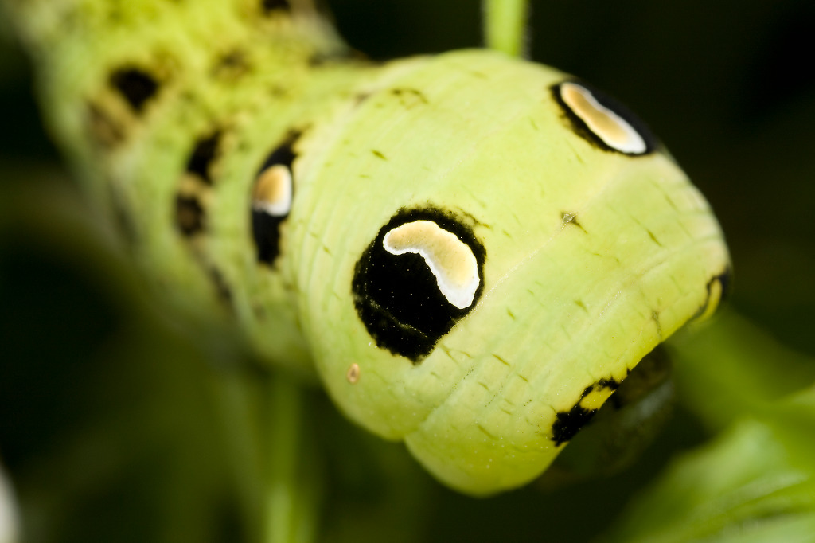
Hawkmoth Caterpillar

Slide 26
Continued…
Mimicry is when one organism looks like another.
An example of this is some insects have bodies that look like the body of a wasp.
Birds often leaves wasps alone because they do not want to be stung.
To a bird, the insect that mimics a wasp looks the same as a wasp.

Slide 27
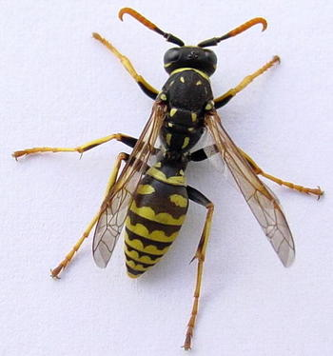
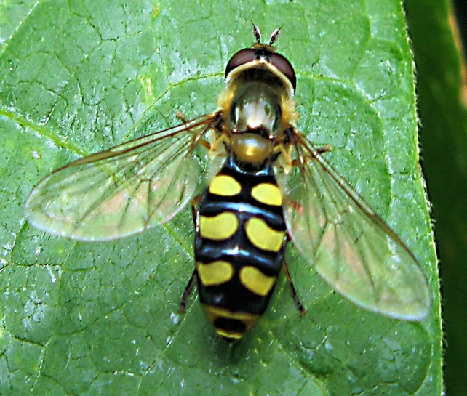
Continued…
Therefore, the birds leave them alone too.
Some kinds of hoverflies even mimic the buzzing sound a wasp makes.
Wasp Hoverfly

Slide 28
Other adaptations animals use to defend themselves.
Opossums “Play dead”
Hedgehog rolls itself into a prickly ball
Pufferfish inflates its body with water

Slide 29
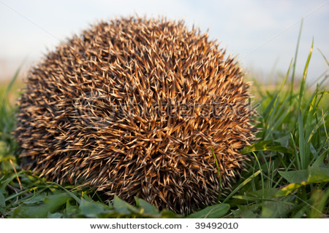

Slide 30
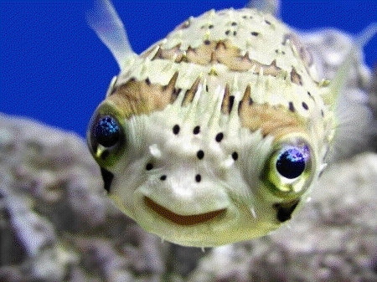

Slide 31
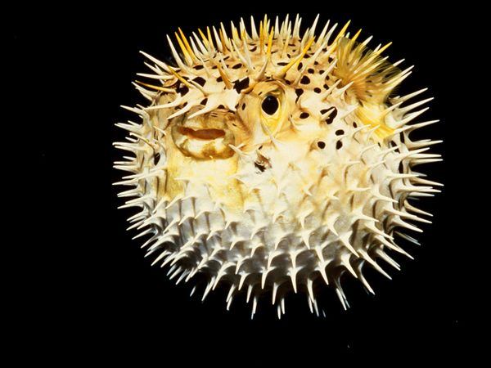

Slide 32
Let’s sum it up.
All these adaptations are ways that animals defend themselves.
They help animals avoid being eaten and to live longer.
They help species to survive.

